Slide 1
Cybersecurity and Privacy: A Current Legal Perspective on Data Privacy, Cybersecurity, and EU Regulations
American Accounting Association
Accounting Information Systems Bootcamp
May 21, 2019

Slide 2
Agenda
Impact of Technology on Privacy
Global Data Protection Compliance: Why So Challenging?
Recent Developments in U.S. and Global Data Protection Laws
Data Protection Compliance Recommendations
Future Trends

Slide 3
Impact of Technology on Privacy

Slide 4
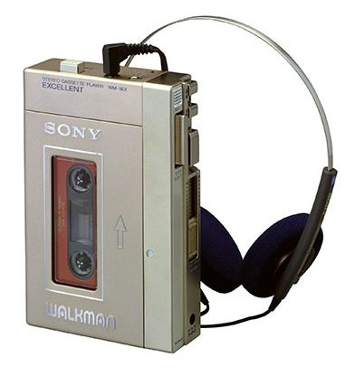
Laura’s Technology in Law School

Slide 5
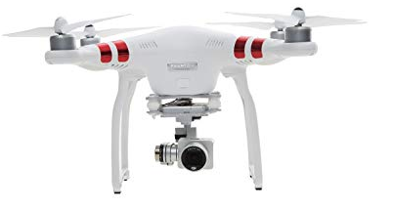
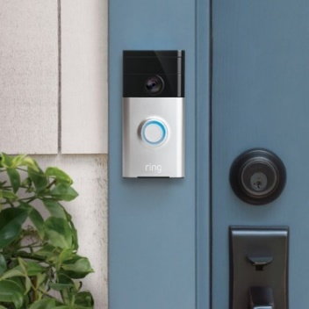
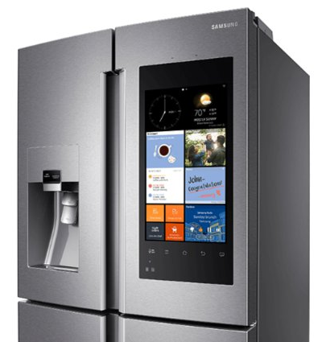
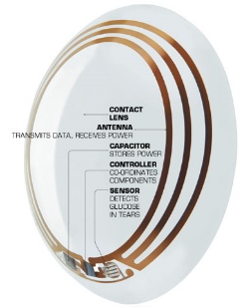
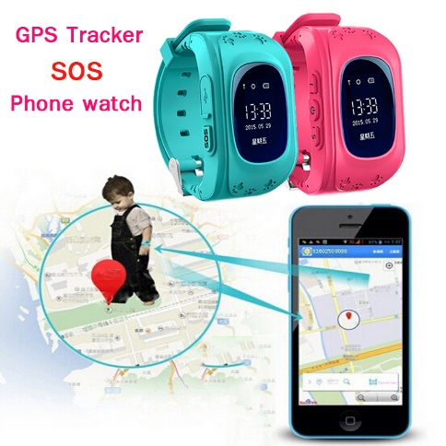
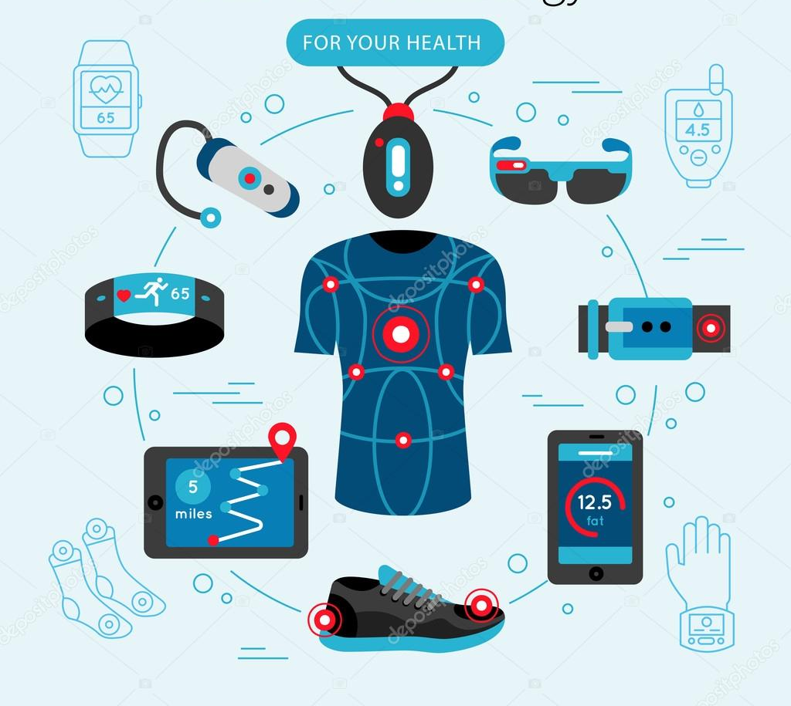
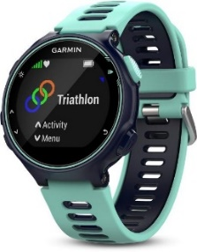
Technology Today

Slide 6
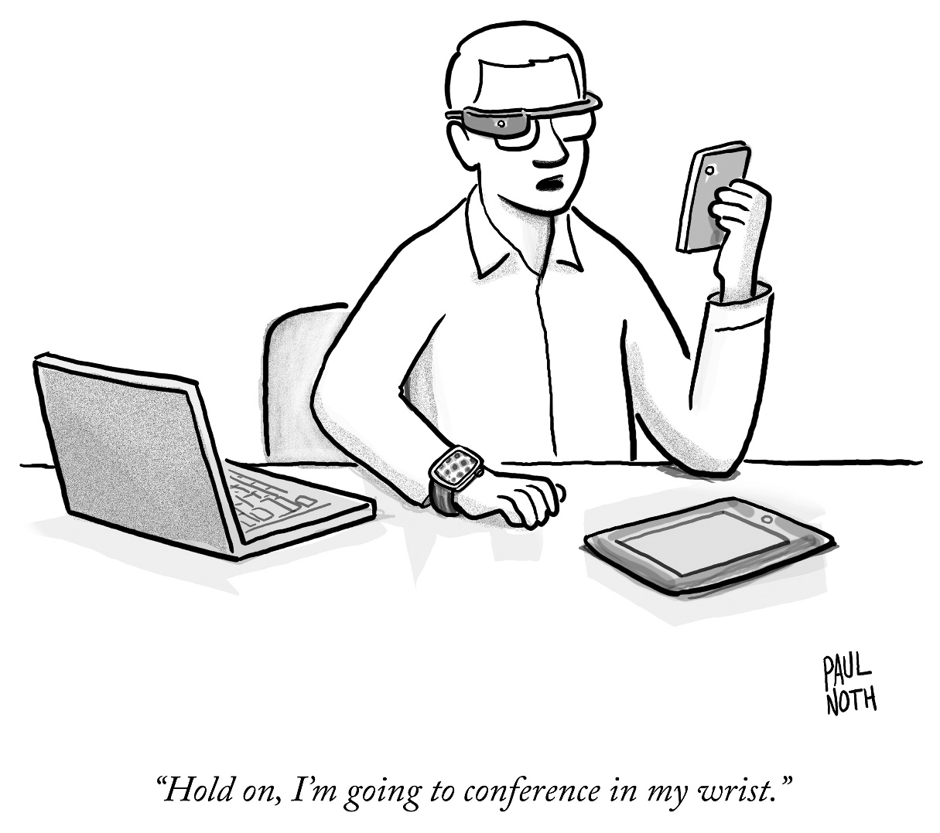
It’s a Brave New World
© 2014 Paul Noth The New Yorker Collection/The Cartoon Bank. All Rights Reserved. Licensed by Fey LLC from cartoonbank.com.

Slide 7
Impact of Technology on Privacy
Ever-Increasing Risk of Unauthorized Exposure of Personal Data
Resulting in Ever-Evolving Global Data Protection Laws
Resulting in Ever-Increasing Security and Privacy Challenges for Organizations

Slide 8
Impact of Technology on Privacy: Headlines

Slide 9
Impact of Technology on Privacy: Headlines

Slide 10
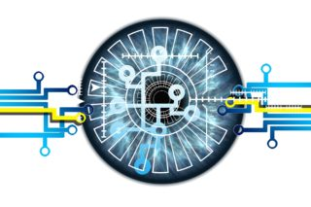
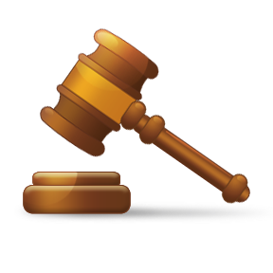
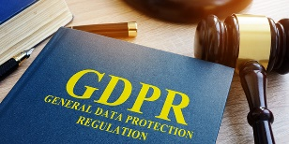
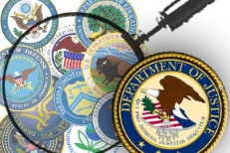
Global Data Protection Compliance: Why So Challenging?

Slide 11
Complex, Constantly Evolving & Expanding Area of Law
Laws Vary Greatly and are
Constantly in Flux
State Laws
Federal Laws
Global Laws
Differing Privacy Perspectives and Approaches
Differing Definitions
Evolving Technologies and Uses of Personal Data

Slide 12
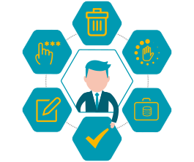
Multitude of Widely Varying Legal Obligations
Information Security
Data Integrity
Notice/Transparency
Consent/Lawful Basis for Processing
Limitations on Use
Limitations on Transfer and Sale
Third-Party Contracting
Data Subject Rights
Restrictions on Electronic Marketing Communications
Data Breach Notification and Incident Management
Data Destruction
Accountability Practices/Recordkeeping

Slide 13
Very Difficult to Wrap Arms around Actual Data Protection Practices
Where’s the Data?
How are We Using the Data?
Who Gets the Data?
Why Do They Get the Data?
How are We Protecting the Data?
Where are the Contracts?
How are We Managing Marketing Communications?

Slide 14
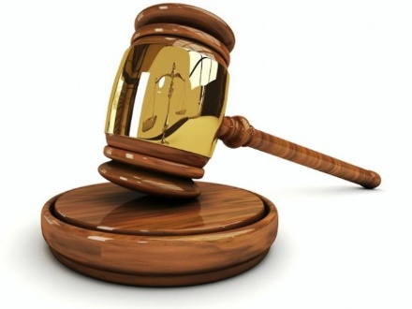
Significant Penalties for Non-Compliance
In Regulatory Context:
Huge Financial Penalties; Criminal Penalties
Prohibitions on Processing Personal Data
Prohibitions on Cross-Border Transfers
In Litigation Context:
Class Actions
Individual Actions
Impact of Joint and Several Liability
In Court of Public Opinion:
Lost Customers
Lost Investors

Slide 15
Recent Developments in U.S. and Global Data Protection Laws

Slide 16
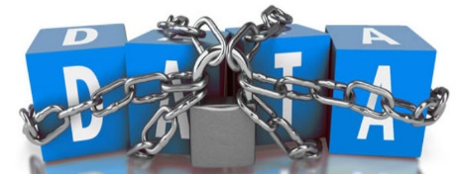
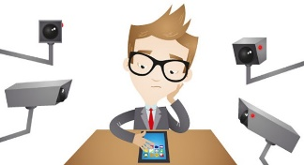
Many Types of State Privacy Laws
Data Breach Notification
Information Security
Third-Party Contracting
Data Disposal
Website Privacy Practices
Employee Monitoring

Slide 17
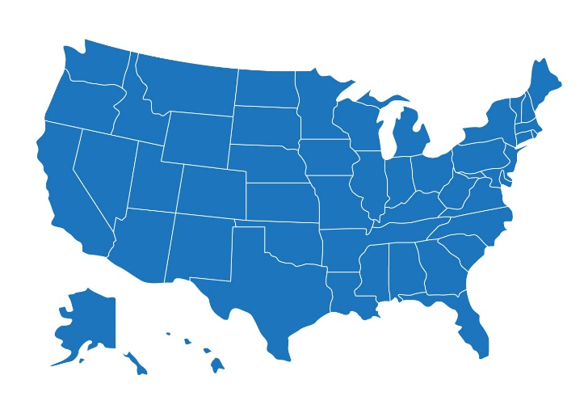
Key Recent State Law Developments
California: Consumer Protection Regulation
Illinois: Biometric Information Privacy Act
Vermont: Data Broker Regulations
California: IoT Law (SB 327)
Colorado: Protections for Consumer Data Privacy Law

Slide 18
California Consumer Privacy Act
Who has to Comply?
What are the Penalties for Non-Compliance?
What Types of Personal Information and Practices are Covered?

Slide 19
CCPA-Readiness
Analyze Applicability to Organization and Affiliates
Prepare Data Map/Create Data Flows
Update Privacy Policy
Prepare “Do Not Sell” Link and Opt-Out Page, if Required
Update Third Party Contracts
Prepare to Address Consumer Requests
Update Security Policies and Procedures
Develop Training Materials
Monitor Legislative and Regulatory Developments

Slide 20
Key Federal Laws
Privacy of Communications: Electronic Communications Privacy Act
Children’s Privacy: Children’s Online Privacy Protection Act
Privacy of Medical Records: Health Insurance Portability and Accountability Act; Health Information Technology for Economic and Clinical Health Act
Privacy of Financial Information: Fair Credit Reporting Act; Gramm Leach Bliley Act; Fair and Accurate Credit Transactions Act
Privacy of Student Records: Family Education Rights and Privacy Act

Slide 21
Key Federal Laws (Cont’d)
Privacy of Identifying Information: Driver’s Protection Act of 1994
Privacy of Genetic Information: Genetic Information Non-Discrimination Act
Privacy of Government-Held Personal Data: Freedom of Information Act; Privacy Act of 1974; Computer Security Act; Section 208 of the E-Government Act of 2002
Prevention of Unfair or Deceptive Practices: Section 5 of the Federal Trade Commission Act
Marketing Communications: CAN-SPAM Act; Telephone Consumer Protection Act; Telemarketing and Consumer Fraud and Abuse Prevention Act

Slide 22
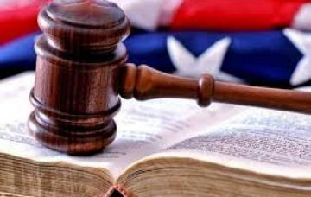
Key Federal Legal Developments
U.S. Data Privacy Bills
FTC Enforcement
Cybersecurity Enforcement and Initiatives by Other Agencies
SEC
HHS OCR
FDA

Slide 23
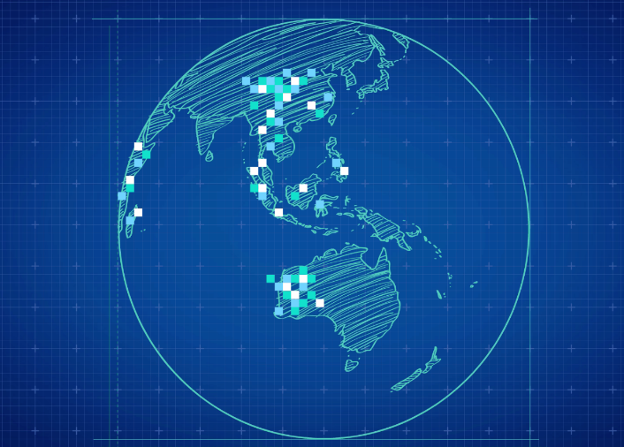
Key Global Legal Developments
Asia Pacific
Implementation of Asia-Pacific Economic Cooperation (APEC) Cross-Border Privacy Rules System
China Proposes Revision to National Standard; Promotes Certification Scheme; Discourages Coerced, Bundled or “Take It or Leave It Consent”; Ministries Announce Legal Ramifications of Violating Cybersecurity Law
Japan-EU Adequacy Agreement

Slide 24
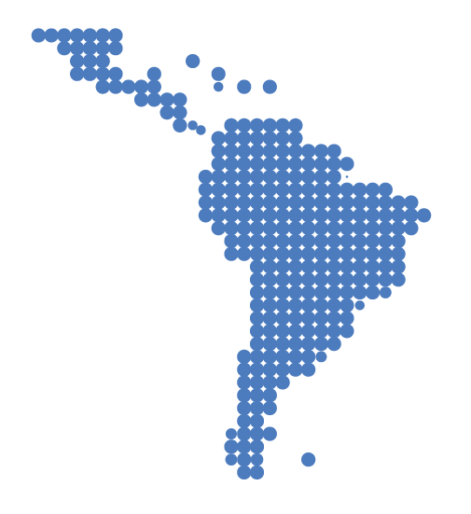
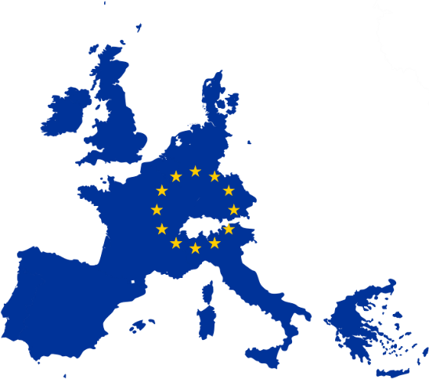
Key Global Legal Developments (Cont’d)
Latin America
Argentina Adopts GDPR-Like Law
Brazil Implements General Data Protection Law
European Union
ePrivacy Regulation
NIS Directive
Russian Data Localization Law
General Data Protection Regulation

Slide 25
EU General Data Protection Regulation
Expansive Reach
Huge Penalties
Extensive Obligations
Broad Definitions

Slide 26
GDPR-Readiness
Analyze Applicability
Prepare Data Map/Create Data Flows
Determine Lawful Bases for Processing
Update Privacy Policies
Update Consent Forms and Practices
Update Third Party Contracts
Determine Lawful Basis for Cross-Border Transfers
Prepare to Address Data Subject Rights Requests
Update Security Policies and Practices
Develop Training Materials
Confirm Compliance with Data Protection Principles, including Data Minimization and Purpose Limitation
Monitor Legislative and Regulatory Developments

Slide 27
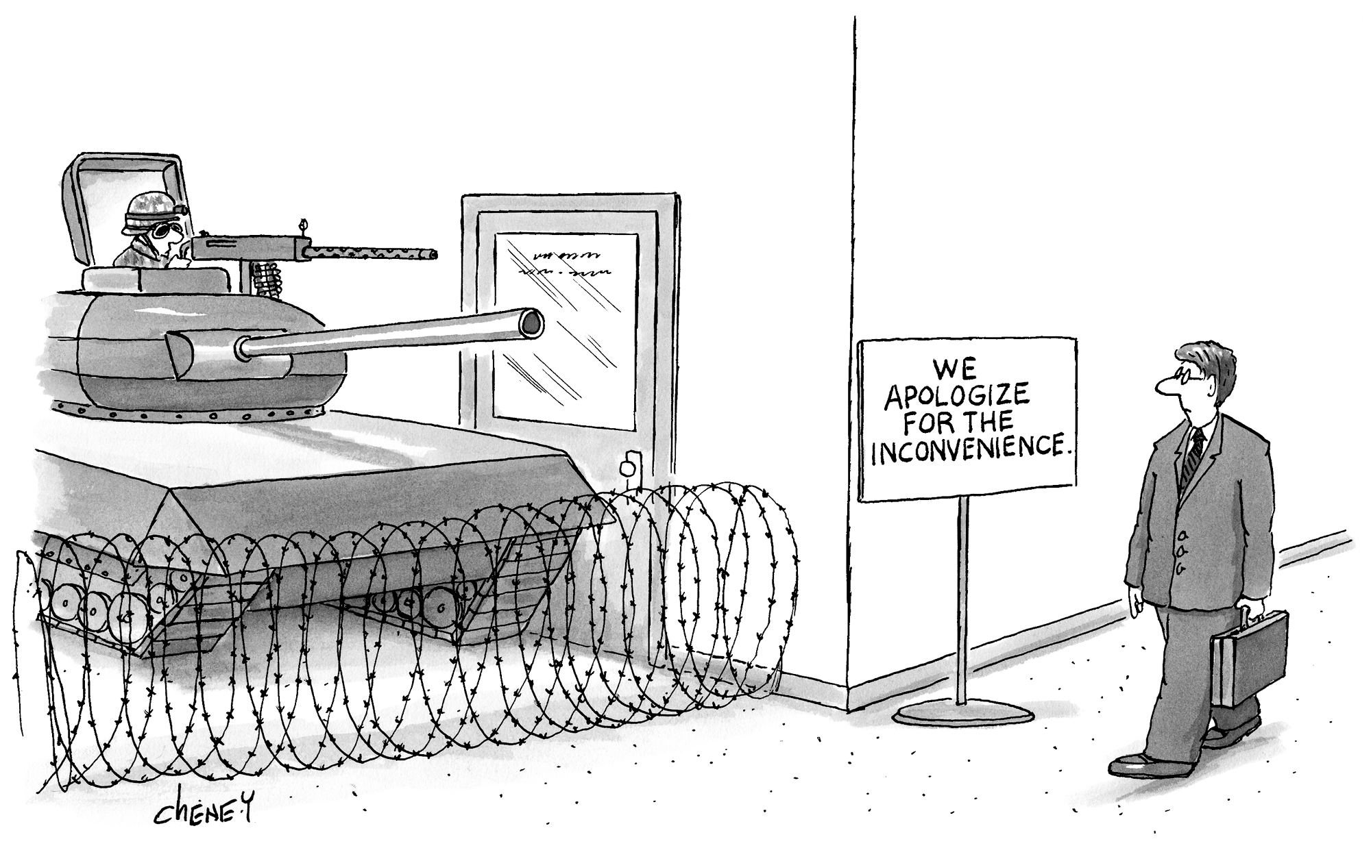
Data Protection Compliance Recommendations
© 2004 Tom Cheney The New Yorker Collection/The Cartoon Bank. All Rights Reserved. Licensed by Fey LLC from cartoonbank.com.

Slide 28
Know Thyself
Conduct Data Mapping and Data Flows
Determine Data Protection Obligations
Perform Risk Assessments
Develop Phased Risk Remediation Plans
Conduct Data Protection Impact Assessments
Implement Data Protection by Design and Default

Slide 29
Know Thy Vendor
Identify All Vendors Currently Receiving
or Accessing Personal Data
Review and Update Contracts
Develop Risk-Based Vendor Selection and Monitoring Processes
Develop Contract Templates and Checklists

Slide 30
Develop/Update Data Protection Framework
People
Policies and Processes
Information Security and Data Privacy Policies and Procedures
Security Incident Response Plan/Procedures
Privacy Notices
Consent Forms
Privacy by Design and Default
Privacy Impact Assessments
Data Subject Rights Processes
Technology

Slide 31
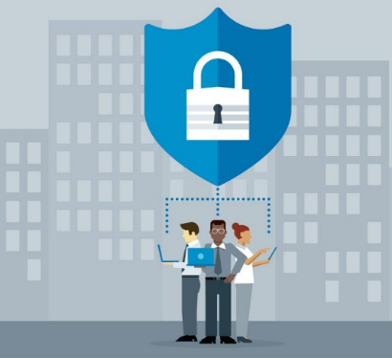
Information Security
Create a Culture of Security
Factor Security into Decisions in Every Department
Make Thoughtful Choices about Personal Data Practices
Look for Early Warnings of Security Incidents
Patch Promptly
Encrypt Sensitive Personal Data
Limit Access

Slide 32
Information Security (Cont’d)
Use Two-Factor Authentication
Implement Appropriate Physical Security
Monitor Use of Technology and Physical Spaces
Retain and Share Data on Need-to-Know Basis Only
Invest in 24/7 AI-Driven Defenses with Human Involvement
Implement Strong Security Incident Procedures and Breach Response Plan

Slide 33
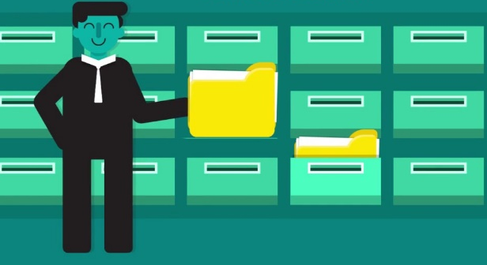
Prepare to Address Data Subject Rights
Notice
Consent
Data Subject Requests

Slide 34
Stay on Top of Ever-Changing Laws
Regulatory Obligations
Enforcement Actions
Asserted Regulatory Priorities
Case Law Developments

Slide 35
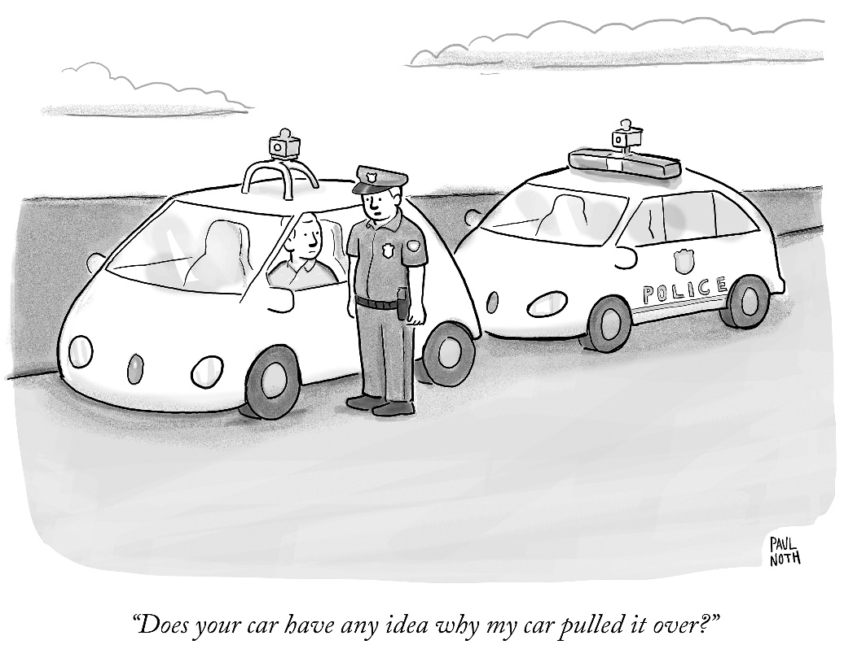
Future Trends
© 2016 Paul Noth The New Yorker Collection/The Cartoon Bank. All Rights Reserved. Licensed by Fey LLC from cartoonbank.com.

Slide 36
Anticipated Technology Trends
Businesses will Invest Heavily in IoT
Our Possessions will Find Their “Voice”
Computing will Move to the “Edge”
IoT Networks will become Increasingly Reliant on AI and Machine Learning

Slide 37
Anticipated Technology Trends (Cont’d)
Targeted Cyberattacks will Increase
Cybercriminals will Deploy Polymorphic Malware, which uses AI to Morph Itself so It Can’t be Found
5G Networks will Broaden the Scope/Availability of IoT
Tech Advances will Require Business to Grapple with Increasingly Challenging Privacy and Ethical Issues

Slide 38
Anticipated Regulatory Trends
Ever-Increasing Global Data Protection Laws and Regulations
Coordinated Enforcement Initiatives
States will Continue to Address Privacy Gaps
State Attorneys General will Be More Active Enforcers
More Governmental Agencies will Focus on Privacy
Momentum will Grow for a Comprehensive Federal Privacy Law

Slide 39
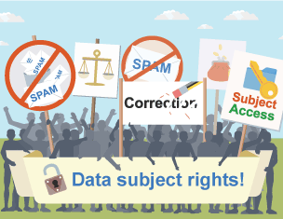
Anticipated Regulatory Trends (Cont’d)
Increasing Regulation of the IoT
Increasing Regulation of Biometric Data
Increasing Focus on Vendor Risk Management
Increasing Interest in Data Subject Rights

Slide 40
Anticipated Regulatory Trends (Cont’d)
More Legal “Safe Harbors” for Compliance with Specific Cybersecurity Frameworks
Increasing Emphasis on Consumer Consent/Control
Facebook will Continue to Drive Privacy Law Development

Slide 41
Anticipated Litigation Trends
Increases in:
IoT-Based Litigation
Negligent Cybersecurity Actions
Data Breach Class Actions
Shareholder and Derivative Cyber Litigation
Actions against Executives and Directors
Expanding Definition of Harm
Personal Data Stores Considered in Antitrust Actions

Slide 42
Bottom Line Prediction for the Foreseeable Future
Increasingly Sophisticated Technologies, resulting in…
Increasingly Sophisticated Cyber Attacks, resulting in…
An Increasingly Complex Cybersecurity and Data Privacy Landscape, resulting in…
Increasingly Higher Stakes for Organizations

Slide 43
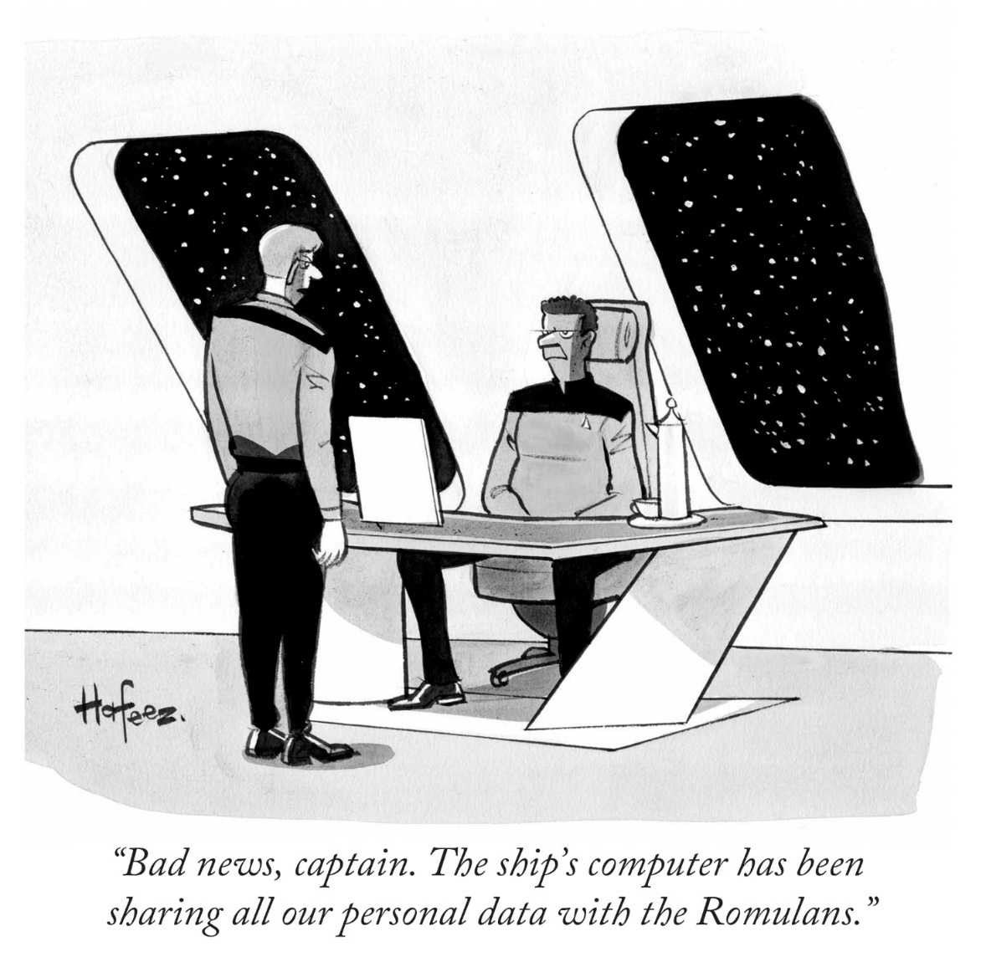
Prepare for A Braver New World
© Kaamran Hafeez The New Yorker Collection/The Cartoon Bank. All Rights Reserved. Licensed by Fey LLC from cartoonbank.com.

